Slide 1
The Pacific Institute Conference
Nashville, TN
April 21-22, 2010

Slide 2
Welcome
Amanda Hartz
  McCann School of Business and Technology / Delta Education Pottsville, PA
  Amanda.hartz@mccann.edu
  Instructor
    Career Development
    General Psychology
    Human Service
  ECE / Human Service Program Director
  Background
    B.S. Psychology from PSU
    Background in mental health / mental retardation

Slide 3
Career development
Course uses two text books:
  Thought Patterns for a Successful Career
    Lou Tice DVD’s
  P.O.W.E.R. Learning for Your Life

Slide 4
Career development
Course Objectives
  Examine his/her own level of personal and professional fulfillment
  Achieve skills to aid in College Success
  State his/her strengths
  Set personal/professional goals
  Identify factors of motivation
  Determine priorities and employ time management skills
  Understand and appreciate cultural diversity in the school and in the work place
  Identify and develop job-seeking and job-keeping skills

Slide 5
My philosophy for the classroom
Maintain a positive attitude
    I have a “no negative words” policy.
Demonstrate professionalism
Model appropriate behavior
Create a nurturing learning environment
Empower students to embrace a positive attitude

Slide 6
Teaching strategies
Lectures
Group activities
Use of audio-visual equipment
Career planning project
Weekly quotes

Slide 7
Weekly quotes
Assignment:
  Reflect on the quote and write a brief statement about what it means to the student

Slide 8
Weekly quotes: actual reflections from students
“There are defeats more triumphant than victories.”
  “To me this quote means more can be learned from defeat than from victories. We learn from our mistakes. Our defeats show us what we do wrong. It teaches us how to correct our faults and gives us the determination to make it right, so it doesn’t happen again. As a result, we feel stronger and more confident.”
    Deb M. (Winter 2010 term)

Slide 9
Weekly quotes: actual reflections from students
“To freely bloom- that is my definition of success.”
  Gerry Spence
    “To freely bloom to me would be coming out of my shell and accomplishing everything I knew I could do but never had the self-esteem or encouragement to do.”
      D.S. (Winter 2010)

Slide 10
Weekly quotes: actual reflections from students
“To freely bloom- that is my definition of success.”
  Gerry Spence
    “I am opening myself up to new beginning, a new life, a new career, a new start and a new me all starting with the first step – I started school.”
      B.M. (Winter 2010)

Slide 11
Group activities to enhance TPI
Newspaper Bridge Building
  A group constructs a bridge out of newspaper that has to be able to support a weight and allow passage of an object underneath.
    www.firststepstraining.com
    Submitted by Linda Foreman, formerly of the Mississippi Development Authority

Slide 12
Group activities to enhance TPI
Newspaper Bridge Building
  Learning Objective: To introduce the idea of teamwork, communication and creative problem solving.
  Props Required: Lots of newspaper, rolls (6-8) of masking tape, a gallon jug 1/4 to 1/2 full of water, a plastic dishpan type container.

Slide 13
Group Activities to Enhance TPI
Newspaper Bridge Building
  RULES SUMMARY:
  Cannot use materials other than newspaper and masking tape.
  Each group to build a bridge that the dish can pass under and hold the gallon jug for 10 seconds.
  Cannot stick/tape to another person or furniture.
  7 minutes to plan; 8 minutes to build the bridge.

Slide 14
Group Activities to Enhance TPI
Newspaper Bridge Building
  THE PROCESS:
Tell them they will have 7 minutes to plan, discuss, etc., and to be sure everyone in the group is included. Time the 7 minutes. After the 7 minute discussion period, pass out the newspaper and tape. Inform the group they will now have 8 minutes to construct their bridge and, by the way, there will be no talking allowed during this 8 minutes.

Slide 15
Group Activities to Enhance TPI
Newspaper Bridge Building
  THE PROCESS (Continued):
At the end of 8 minutes, allow the groups 30 seconds to speak to each other and then an additional 3 minutes of SILENTLY work to complete their bridge.
Call time and have one group at a time present their bridge. A spokesperson from each group will tell about their bridge and pass the pan under and put the jug on top. When the jug is put on top, all will count for 10 seconds.

Slide 16
Group Activities to Enhance TPI
Newspaper Building Activity
  DISCUSSION QUESTIONS:
How did you work as a group?
Which part was the most difficult?
Did everyone participate in some way?
Did you feel like you contributed to the group?
Did you feel like you were part of the group?
Was there one particular person that kept the ball rolling?
Were there individuals who were particularly quiet?
How was their quietness interpreted: agreement or disagreement?
What influenced the type of bridge built by each group?
Why were no two alike?

Slide 17
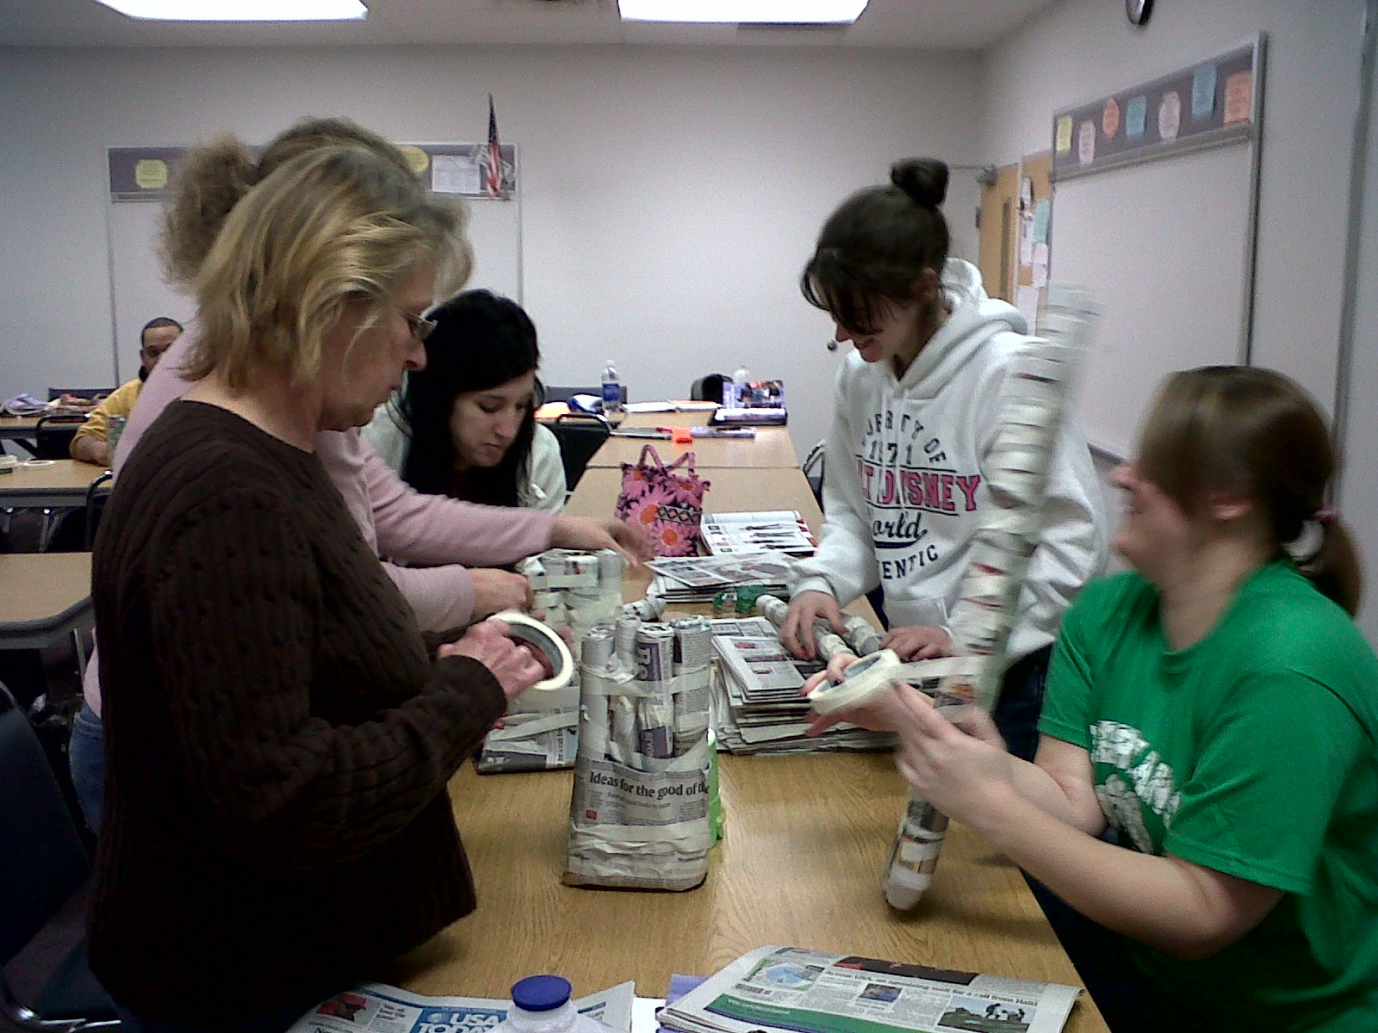
Building bridges group activity

Slide 18
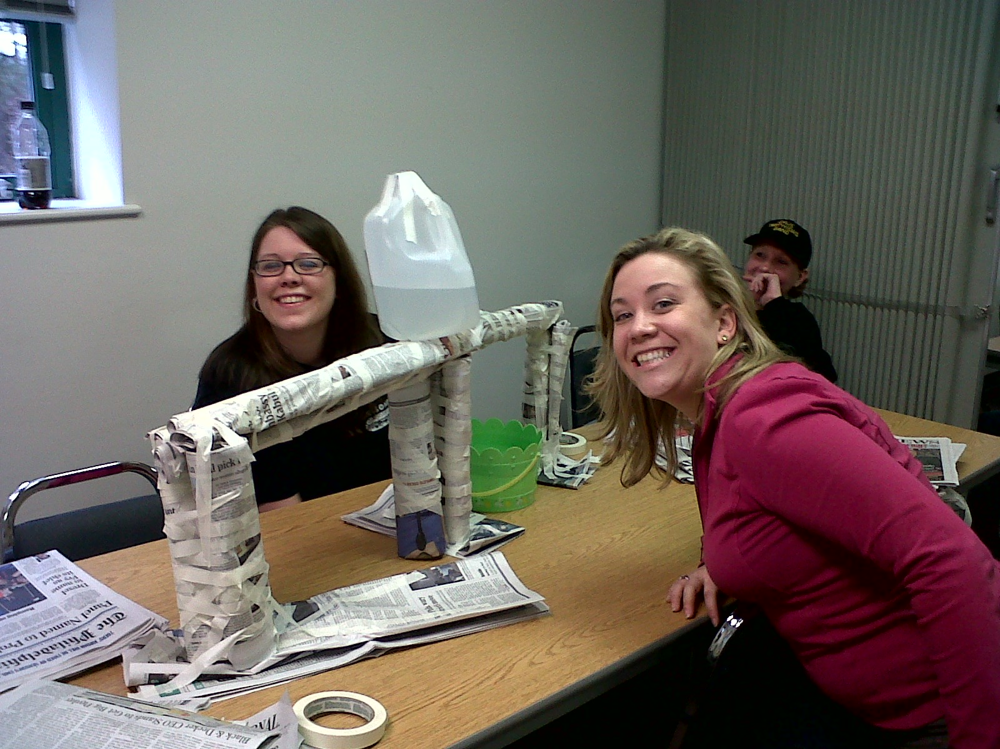
Building bridges group activity

Slide 19
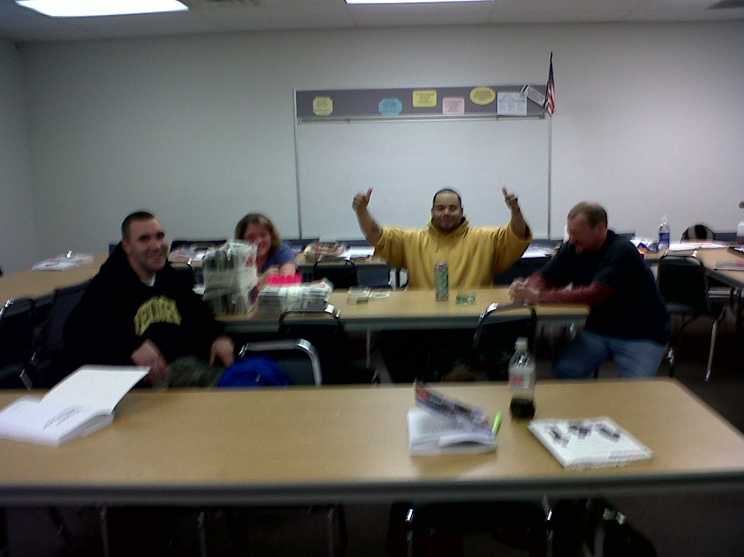
Building bridges group activity

Slide 20
Group Activities to Enhance TPI
Coping Support Kit
  http://www.recreationtherapy.com/tx/coping.htm
  Submitted by Cindy Clark of the VA Hospital
  Equipment:
  Plastic Bag(s) (Ziploc bags preferred)
  Eraser
  Penny
  Marble
  Elastic
  String
  A heart type of candy

Slide 21
Group Activities to Enhance TPI
Coping Support Kit
Objective: To support new students with coping skills.
Description: Put all equipment in a baggie. Attach a note that reads:
  "Here is your personal coping kit. It contains an eraser to make mistakes disappear; a penny so you will never be completely broke; a marble for when you are sure you've lost yours; an elastic to help you stretch beyond your means; a string to hold life together when it seems to be falling apart; a heart candy to remind you that someone cares about you!!!"

Slide 22
TPI BEST PRACTICES
McCann, Pottsville

Slide 23
Best Practices at Our Campus
Attitude! Be Happy and Smile ☺
Bulletin Boards: Program related signs, posters, quotes
Be positive! Speak to EVERYONE!
Vent in the faculty rooms, not in the hallways, outside or in the classrooms!!
TPI Booster Shots!! A refresher course for the staff and faculty!

Slide 24
Best Practices with our Students
Encourage students to enlist, “Study Buddies” to help decrease test anxiety
Encourage journaling in all classes
Have students set short term and long term goals
Have students create vision boards of what they want their future to look like
Foster a POSITIVE attitude around students, with the goal that it will be contagious!!

Slide 25
Faculty/Staff Thoughts:
The Pacific Institute

Slide 26
Positives About TPI
From the Instructor’s Perspective:
Locus of Control
Expand the comfort zone
Gaining confidence
Knowledge of how the mind works
Create new habits – get rid of bad habits
Accept responsibility for themselves first
Goals are keys to be successful in life
Cause and effect
Free flow class
Journaling
Build self-esteem
How to accomplish goals
Awareness of how low self-esteem was created
Be careful of who you listen to
Ways to cope
Plan A, B, C
Reinforce staying in school
Scotomas
Success
Potential
Ban negativity
Efficiency and effectiveness

Slide 27
And From The Director of Education
I gained first-hand experience seeing the growth process and excitement of students being able to examine their beliefs and habits and seeing they ultimately can make a change in their lives.
The ending of the course in comparing to the “Wizard of Oz” at first was surprising to me – but after reflecting I felt that we are all like the characters in that film.
We need the courage to prevail. We all have crossroads and avenues. We need to find the path for us – “our own yellow brick road.”
We all have heart – and need to get out of our comfort zones and help others – we can all make a difference.

Slide 28
The Journey of so Many…..
THE PACIFIC INSTITUTE
Can Change Lives!!

Slide 29
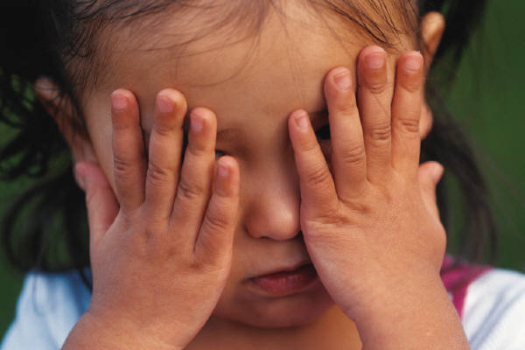

“Unstoppable” - By Rascal Flats

Slide 30

“Unstoppable” – Rascal Flats

Slide 31
“Unstoppable” - By Rascal Flats

Slide 32

“Unstoppable” - By Rascal Flats

Slide 33


Slide 34
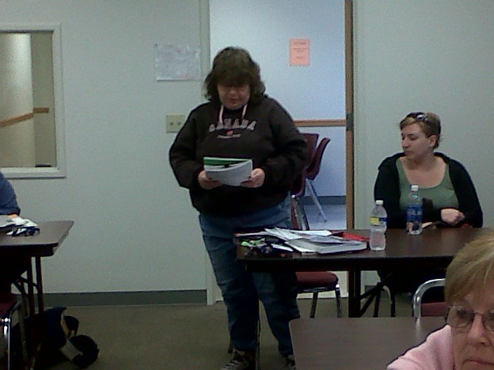
Pictures of McCann Students whose Lives are changed

Slide 35
Pictures of McCann Students whose Lives are changed

Slide 36
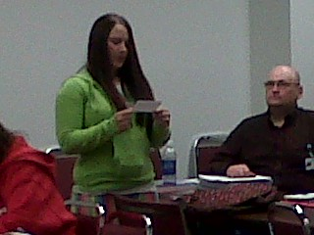
Pictures of McCann Students whose Lives are changed

Slide 37
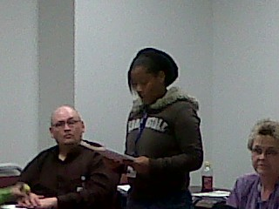
Pictures of McCann Students whose Lives are changed

Slide 38
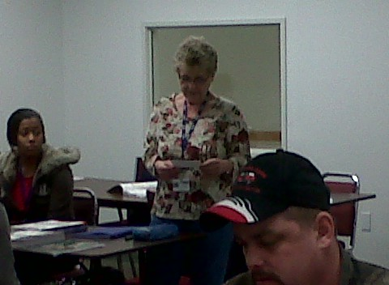
Pictures of McCann Students whose Lives are changed

Slide 39
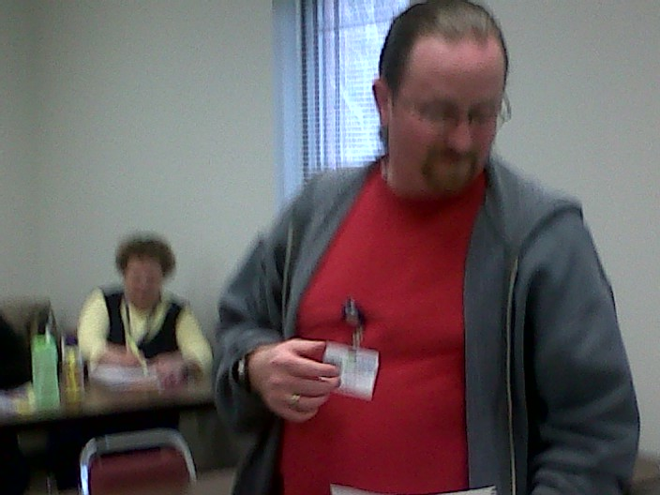
Pictures of McCann Students whose Lives are changed

Slide 40
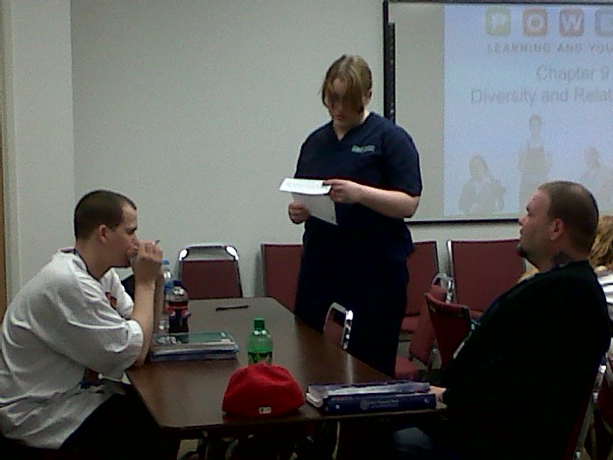
Pictures of McCann Students whose Lives are changed

Slide 41
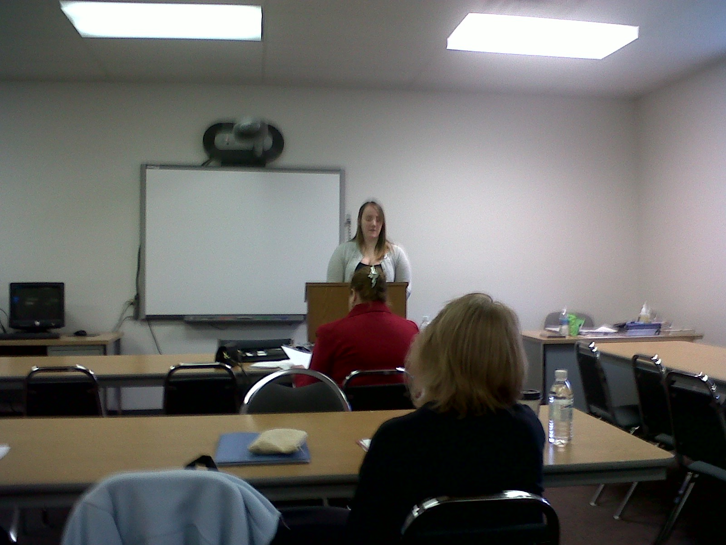
Pictures of McCann Students whose Lives are changed

Slide 42
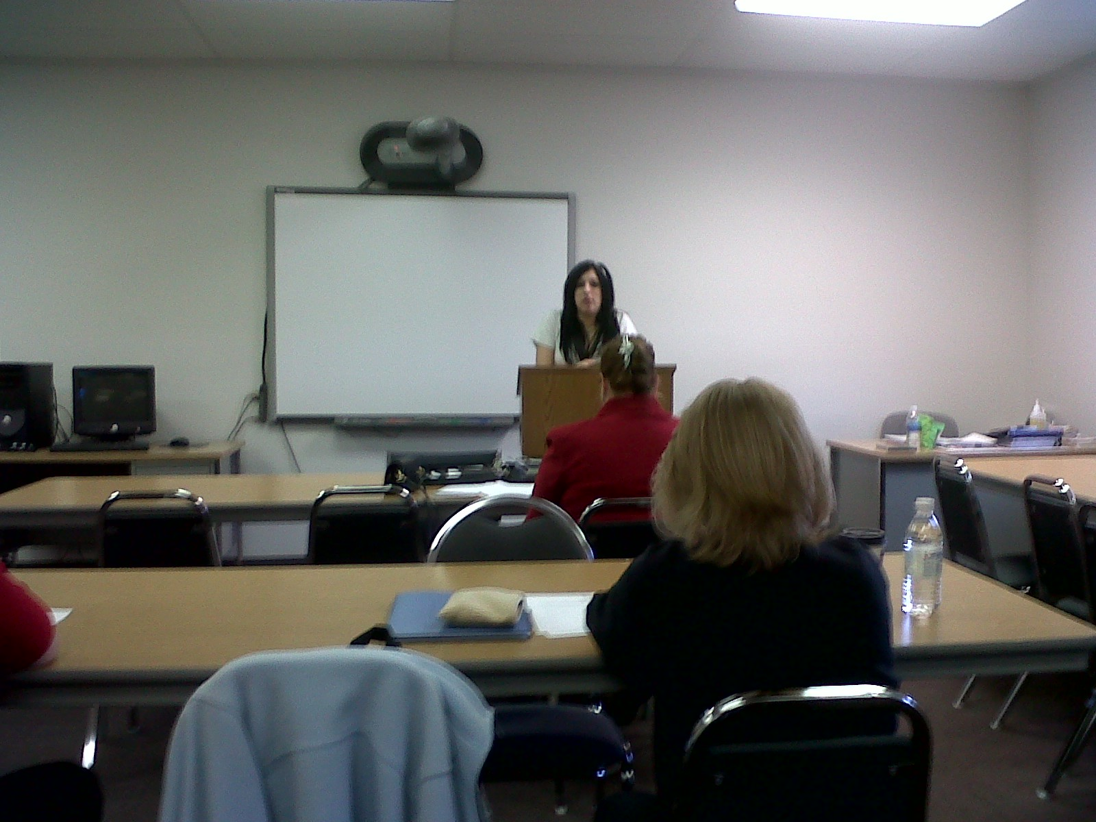
Pictures of McCann Students whose Lives are changed

Slide 43
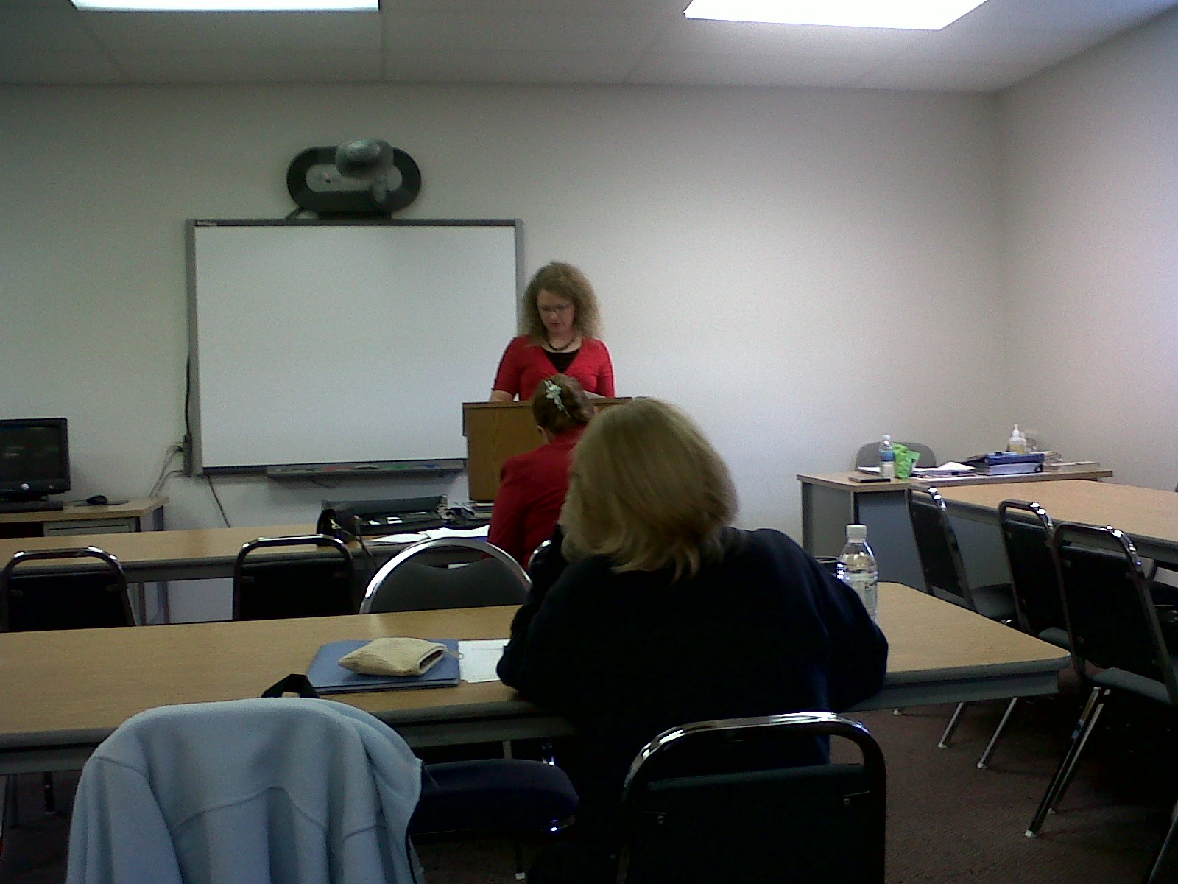
Pictures of McCann Students whose Lives are changed

Slide 44
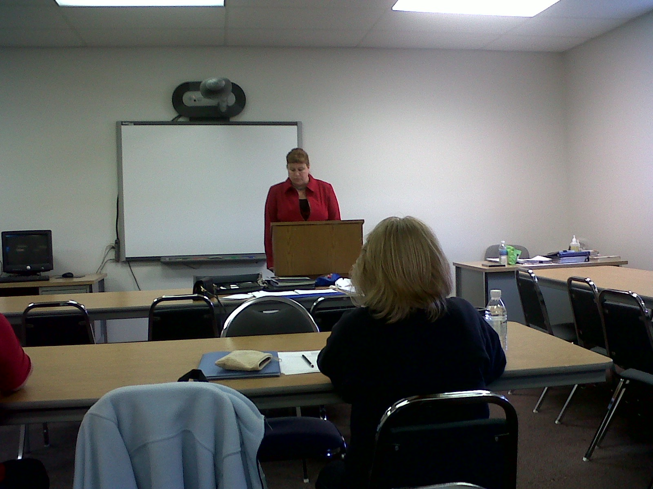
Pictures of McCann Students whose Lives are changed

Slide 45
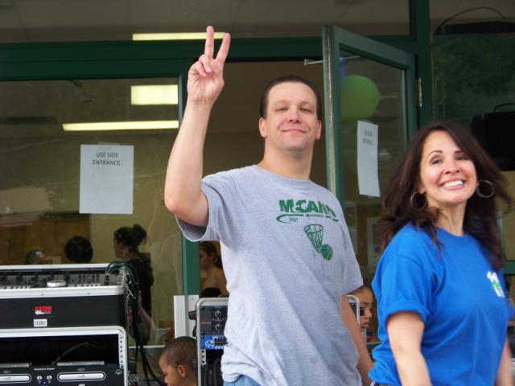
“When you are Stuck – Don’t Quit!”
-Lou Tice

Slide 46

“UNSTOPPABLE!!”
“You are very smart and capable.”
- Lou Tice

Slide 47
What Are the Students at McCann Saying about The Pacific Institute?
“Lou Tice is a genius. I am using this stuff with my 9 year old daughter. It really WORKS! I have a better relationship with her now.”
    Joe L. (Winter 2010)
“Lou was a great inspiration. I will remember the quotes, especially; “It’s ok to be afraid, it’s not okay to stay afraid.”
    Sandy T. (Winter 2010)
“I do not let negative people influence me anymore. I think positively.”
    Karen W. (Winter 2010)

Slide 48
What Are the Students at McCann Saying about The Pacific Institute?
“I will be a positive wizard to others that I meet.”
    Scott G. (Winter 2010)
“I now always tell myself that I want to be at school rather than I have to be at school. I am more motivated now because of this.”
    Amber R. (Winter 2010)
“My instructor has this rule that we are not allowed to use negative words and phrases because they hold us back. I believe that if you follow her advice, we will be better people in the future.”
    Brian F. (Winter 2010)

Slide 49
What Are the Students at McCann Saying about The Pacific Institute?
“The fact that Lou has helped me learn how to vision my future and where I want to be.”
    Jasmine N. (Winter 2010)
“I am going into math class knowing I can do the work and changing the way I learn.”
    Liz N. (Winter 2010)
“When we started our lessons with Lou, I set a goal to not miss any days and pass all courses with A’s. I have done both!!”
    Brittney N. (Winter 2010)

Slide 50
What Are the Students at McCann Saying about The Pacific Institute?
“Lou has been a positive influence in my life and in the lives of my family.”
    Jacob B. (Winter 2010)
“This class helped me set goals and taught me not to listen to all the negative.”
    Andrew C. (Winter 2010)
“When I am unsure, I will think of Lou and smile. ‘Cause then I will definitely know I CAN do it!”
    Tina S. (Winter 2010)

Slide 51
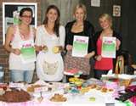

Slide 52
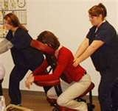

Slide 53
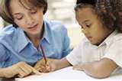

Slide 55
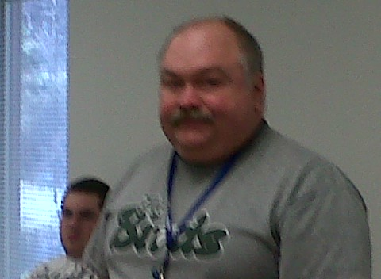
McCann Students are “Unstoppable!”
Together we Will Change the Future!

